Slide 1
SAMHAR COVID-19 Hackathon
Detecting suspicious activities using Deep Learning approach
Team:
Ankur Gupta
Achal Sharma
Anuj Gupta
Adarsh Agrawal

Slide 2
Solution Overview
Problem Statement
With Covid-19 becoming a pandemic, there is a need to track suspicious flu related activities such as coughing, sneezing, etc. using public surveillance systems. The objective here is to find different pattern on input sources like camera, satellite, social platforms which can help identify suspicious activities to stop or track covid-19 spread.
Approach for POC
Using object detection models like Inception V3 to get the deep-features of each frame in the activity video.
Passing the features in the LSTM model to detect the presence of an activity.
Additional proposed modules
Increasing our dataset to include flu symptoms related activities like Coughing, Sneezing, etc.
People detection in the crowded scenario. This will enable us to track a person performing suspicious activity in a crowd.
Train an ensemble model to increase the accuracy of the current model.
Data Used
UCF-101 (https://www.crcv.ucf.edu/data/UCF101.php)
Activities involved – Biking, Push ups, Wall Push ups, Playing Guitar
Git Repository

Slide 3
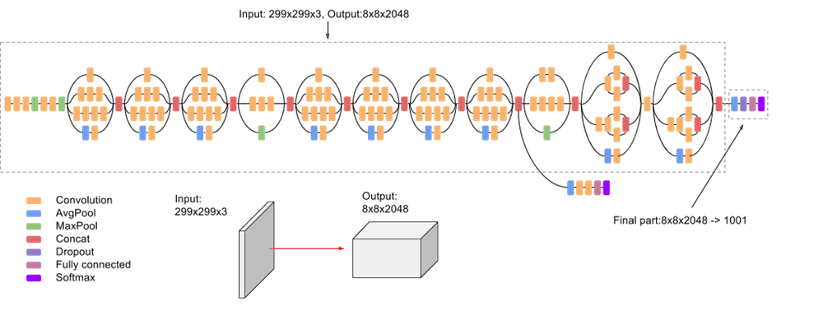
Analytical Workflow – Model Architecture
Inception V3
LSTM Layer
Dense Layer
Dropout Layer
Dense Layer
Above is the basic flow used in the model. Below is some description regarding the components –
LSTM – These are type of RNN (Recurrent Neural Networks) blocks, which are used mostly to learn the temporal behavior in the datasets, these are formed by different gates which learns as the model is trained what temporal sequence to remember
Dense layer – These are normal fully connected layer of neural networks
Dropout layer – This is to eliminate the overfitting while model training, for each epoch some of the activation unit in the dense layer are shut off (no learning happens), according to the probability assigned
Inception v3 – Pre-trained image classification model. Below is the architectural diagram for the model

Slide 4
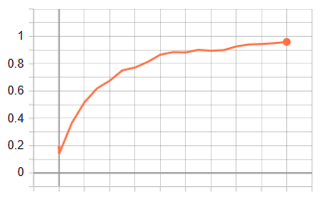
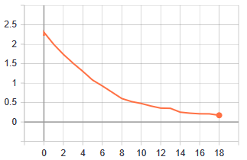
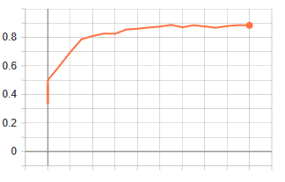
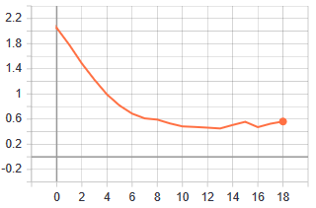
Analytical Workflow – Training Approach & Results
Each video is divided into frames and each frame is passed through the InceptionV3 model to obtain the deep features which are then analyzed using LSTMs for classification.
InceptionV3 + LSTM
Inception v3 is a widely-used image recognition model that has been shown to attain greater than 78.1% accuracy on the ImageNet dataset
The features are generated using the second last layer of the network since the last layer will give us the probability of the image classification, which is not required.
The features generated is used as a feature to be fed to the LSTM layer, which will learn the temporal features across the frames.
Currently, only 4 classes are trained using the network
Model’s parameters used
Video frames – 240 x 320 pixels
Activities trained on – Biking, Push ups, Wall Push ups, Playing Guitar
Inception v3 output features shapes – Since each video contains only single activity, features are generated on 40 frames sampled from the video. Each frame is passed through the pre-trained inception network which will result output feature shape of 40 x 2048
Output of the LSTM + Dense model will be probability of each class.
Training Accuracy
Training Loss
Test Accuracy
Test Loss
Model performed quite well on the used 4 classes
Train Accuracy ~97% | Test Accuracy ~89%

Slide 5

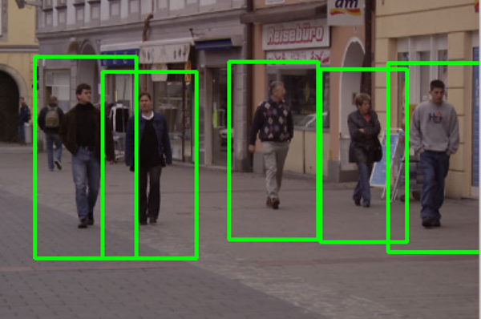




Proposed Solution Architecture
Preprocessing Engine
Live Video
Video Manager
Live Video
Surveillance
Camera
Archived
Video
Dashboard
Analytical Engine
(Feature Extraction + Activity Detection)

Slide 6
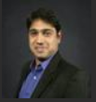
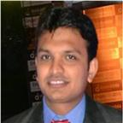
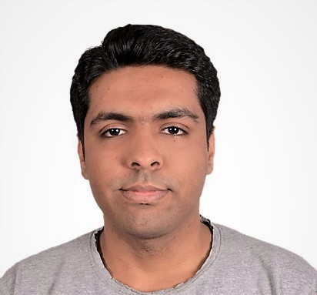
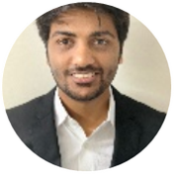
Team Profile
10 years of experience into Big Data, Analytics and the Software industry. Expertise in Internet of Things and building predictive models based on sensor data. Prior experience with Samsung, AXA, Absolutdata Technologies.
Ankur Gupta
Anuj Gupta
Achal Sharma
5 years of experience in Big Data, Analytics and Engineering. Expertise in handling large datasets & creating optimized analytical solutions using various data science tools and languages like R & Python.
4+ years of experience in Big Data analytics with experience in creating end to end data pipelines, designing text analytics and predictive analytics solutions. Expertise in Python, Spark and Hadoop ecosystem.
Adarsh Agrawal
Experience in working with distributed computing environment such as Hadoop and working on deep learning computer vision problems
B. Tech. Computer Science
B.E. Information Technology
B. Tech. Electronics & Comm.
B. Tech. Civil Engineering

